Slide 1
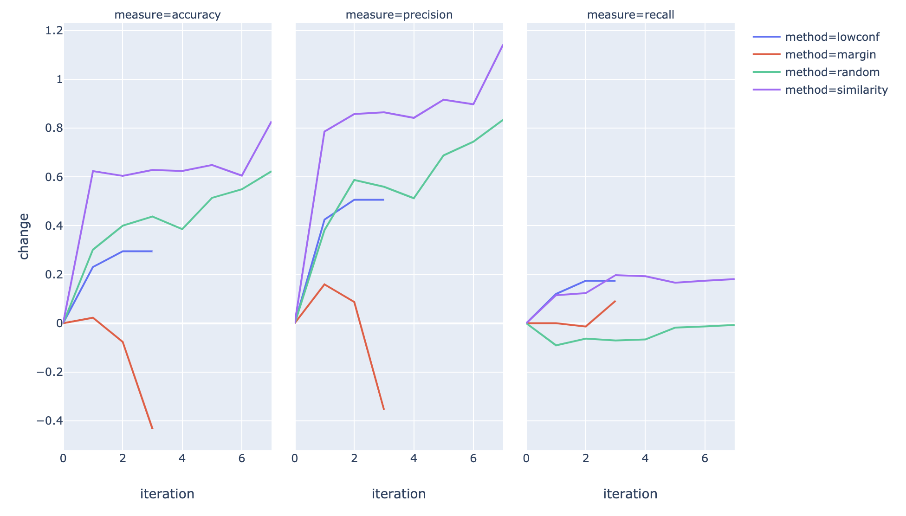
Travel

Slide 2
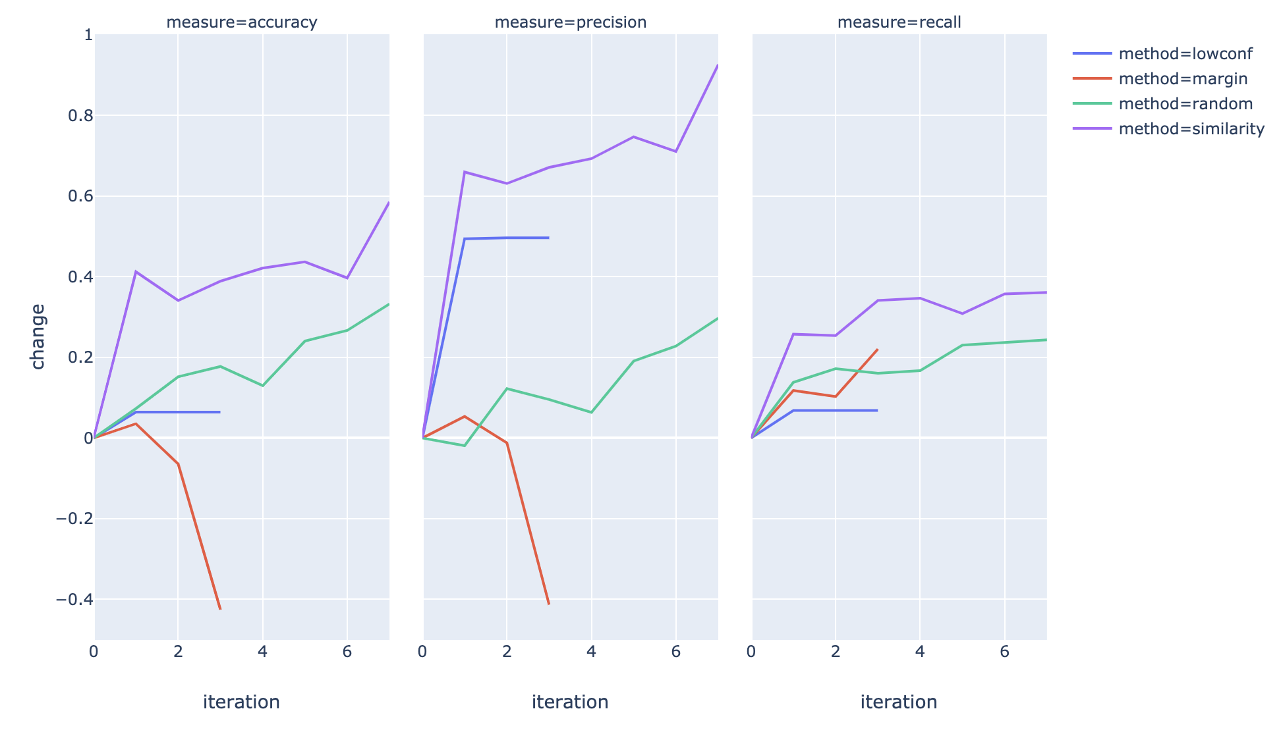
Personal

Slide 3
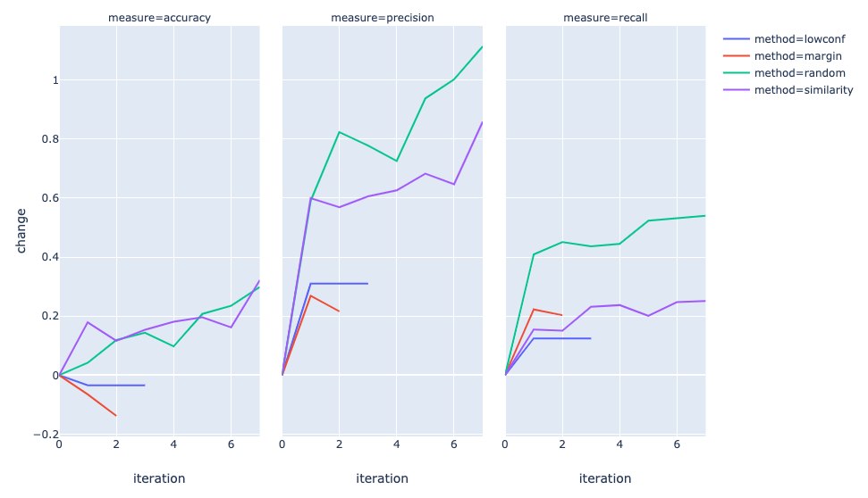
payments

Slide 4
Travel
Payments
Personal

